Slide 1
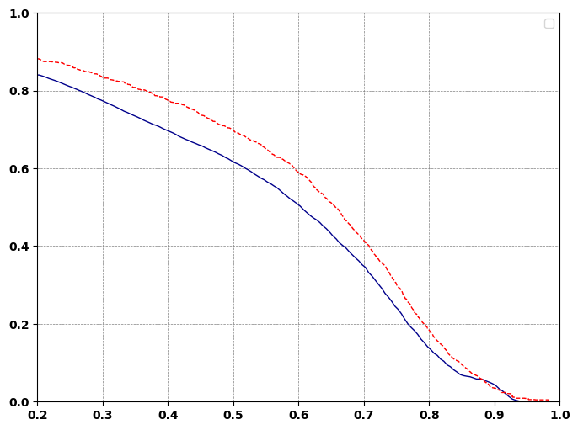
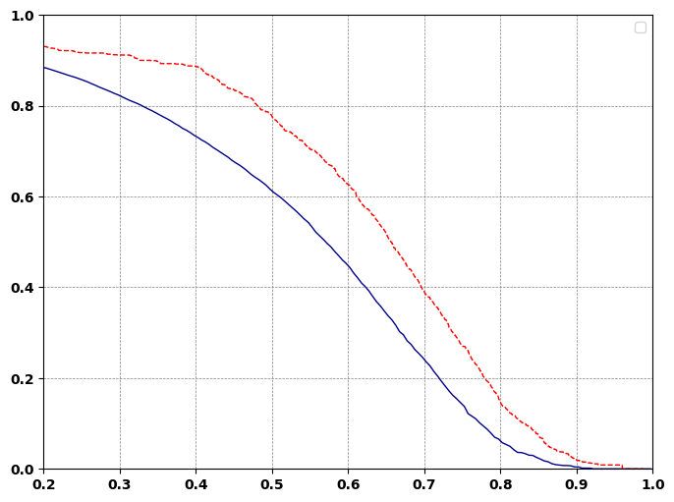
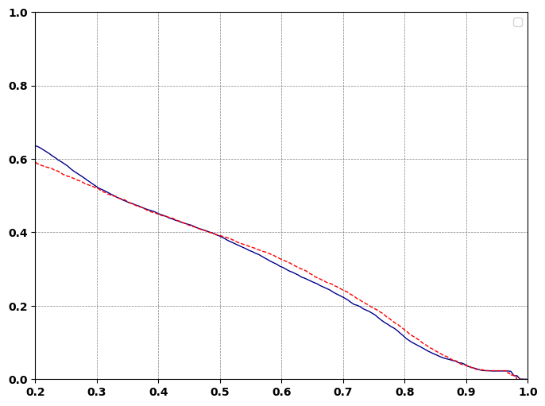
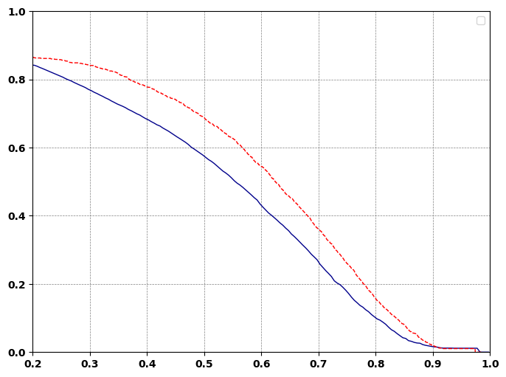
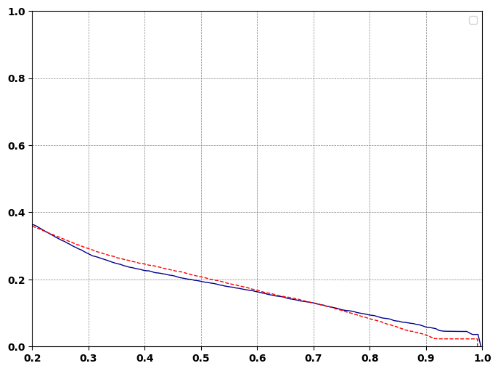
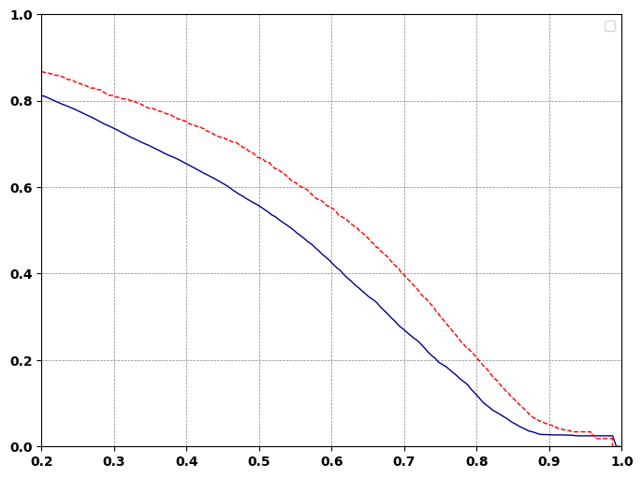
a.
b.
---- EstimatedFDR
Res35k,noise1e3
Res35k,noise1e5
True FDR
c.
d.
Res70k,noise1e3
Res70k,noise1e5
Qvalue or FDR
e.
Res140k,noise1e3
f.
Res140k,noise1e5
Qscore
Notes:
11/04/25 for iso1

